Slide 1

COMS W4111 - Introduction to Databases
We’re Done (Almost), Yeah!
Donald F. Ferguson (dff@cs.columbia.edu)
Lecture 13: We’re Done(Almost), Yeah! © Donald F. Ferguson, 2020

Slide 2

We will start in a couple of minutes
Lecture 13: We’re Done(Almost), Yeah! © Donald F. Ferguson, 2020

Slide 3
Agenda
Lecture 13: We’re Done(Almost), Yeah! © Donald F. Ferguson, 2020

Slide 4
Today’s Agenda
End of semester logistics and dates.
An aside on Spark/AW Glue
Some data processing and analysis
Denormalization, Wide-Flat-Tables
Pandas
Plotting.
Object “Relational” Mapping
Web Application Walkthrough
The 5 V’s and Streaming Data
Some Examples, or ”Watch Professor Ferguson Mess Up.”

Slide 5
End of Semester Logistics
Lecture 13: We’re Done(Almost), Yeah! © Donald F. Ferguson, 2020

Slide 6
End of Semester Logistics
Office hours:
The TAs will continue office hours through end of the semester. There may be some rescheduling because they are also students with assignments and exams.
I try to hold OH/recitation every day through final exam submission. I do not always know the time in advance but will give as much notice as I can.
HW/Exams:
HW 4, part 2 due 13-Dec.
HW 4, part 3 due 14-Dec. I will go through some of the material today, and am available for most of the weekend.
Finals exam:
Target release date 14-Dec. Target due date 20-Dec.
Take home exam similar to the midterm.
HW5: Tentative release 16-Dec. Extra credit and very simple.

Slide 7
An Aside
Lecture 13: We’re Done(Almost), Yeah! © Donald F. Ferguson, 2020

Slide 8
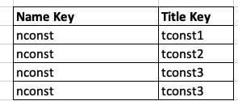
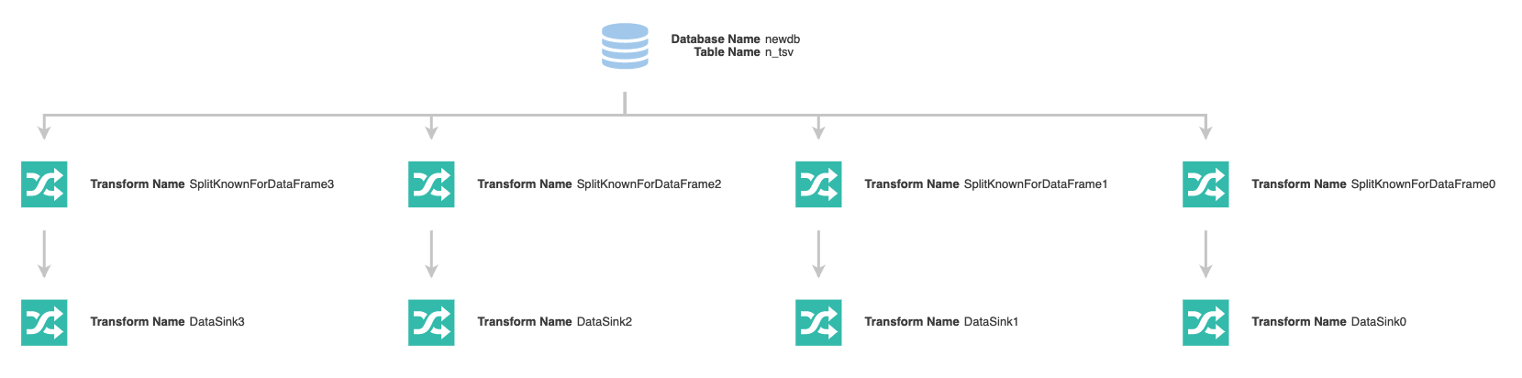
An Aside on Spark and AWS Glue
If you remember, we have the problem of
Mapping (nconst, “tconst1,tconst2,tconst3,tconst4” to
I wrote a Spark job to do it
Each node is parallelizable.
I can assign multiple machines to implement the job.

Slide 9
Denormalization Pandas Plotting
... ...
Lecture 13: We’re Done(Almost), Yeah! © Donald F. Ferguson, 2020

Slide 10
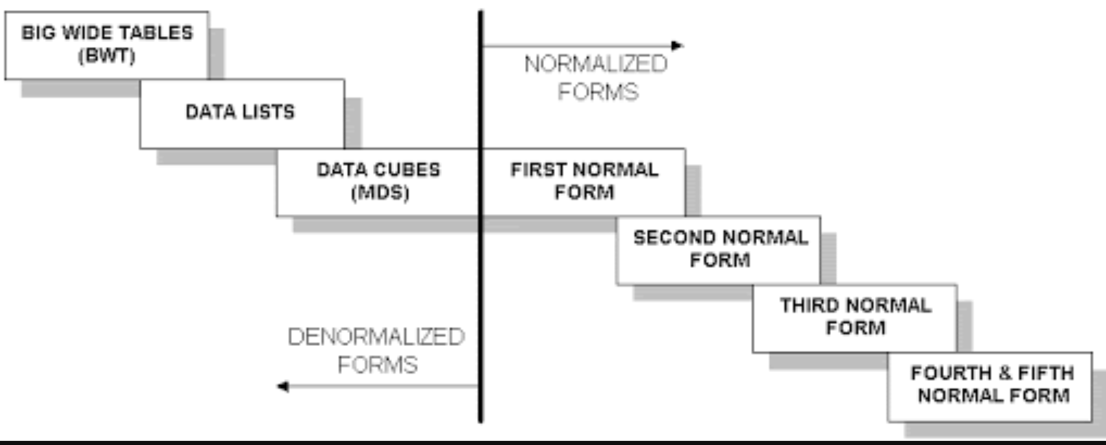
Normalization/Non-Normalization
Good for query.
Good for integrity.
“Database Normalization is a technique of organizing the data in the database. Normalization is a systematic approach of decomposing tables to eliminate data redundancy(repetition) and undesirable characteristics like Insertion, Update and Deletion Anomalies.” (Studytonight)
Well, if things were composed, it means people like to think of them composed:
COMSW4111 versus four or five domains (Dept, Faculty, Level, Course No).
COMSW4111, Introduction to Databases, 002, Spring 2020, ...} versus Section(...) → Course(...)
Decomposing is good for data integrity, but recombing for query is expensive.

Slide 11
Normalization/Non-Normalization
Consider Classic Models Database
The database is relatively well normalized.
We have seen a couple of issues they should be fixed.
Let’s consider some common questions:
“What are the top 10 products in EMEA?” This is requires:
Products (for name)
Orders
OrderDetails
Customers (for country)
External table that maps countries to regions.
“Which employees are driving the most revenue?” This requires:
Employees
Customers
Orders
OrderDetails
In a normalized database,
Common queries require a lot of joins.
But, joins are slow.

Slide 12
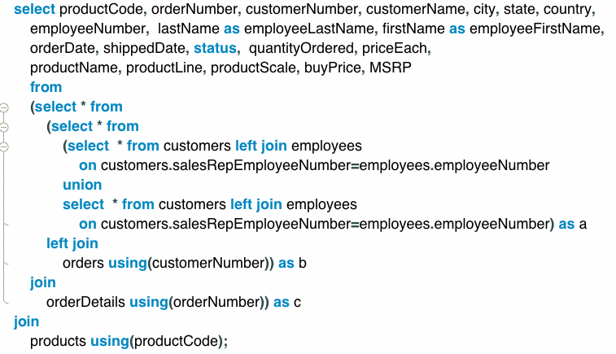
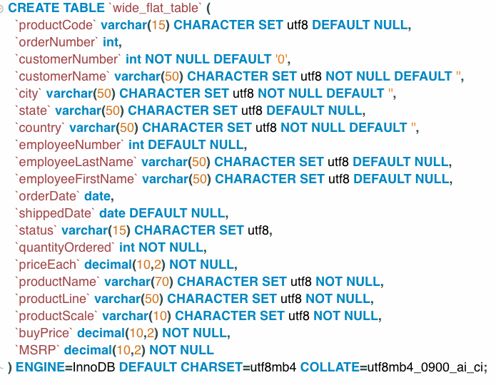
Wide, Flat, Table
Let’s build a “wide, flat, table” and look at queries.

Slide 13
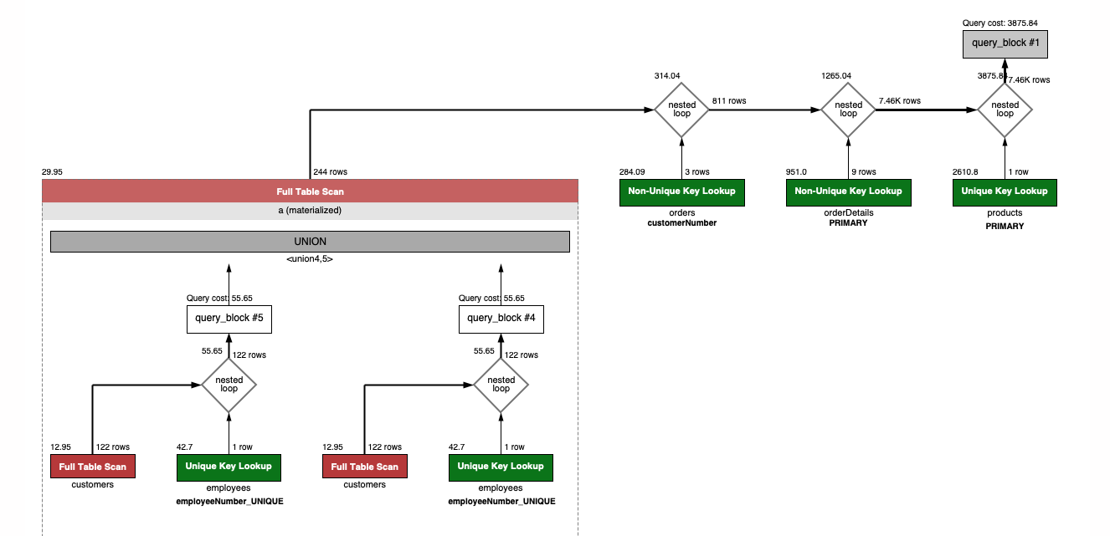
Wide, Flat, Table
Let’s build a “wide, flat, table” and look at queries.
Create table wide_flat as select ... ...
A single scan can answer a lot of interesting questions.
Customers, products, countries
Orders, products, dates
... ...
Queries are relatively simple and fast.

Slide 14
Let’s Look at the Data
Switch to notebook

Slide 15
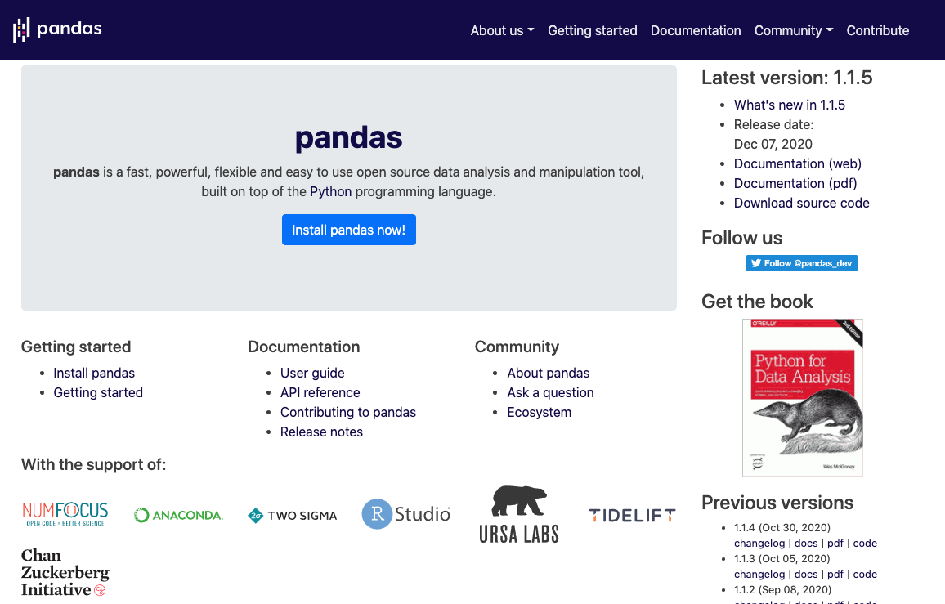
Pandas

Slide 16
Python Science/Engineering Ecosystem

Slide 17
Putting Pieces Together
Pandas versus SQL
Relational databases query and manage staggering amounts of data.
If you tried to load huge data into a data frame, the client (e.g. Notebook) would hang or crash.
The basic approach is:
Build you denormalized tables supporting a broad class of queries.
Use SQL to produce smaller, manageable “data frames.”
Constantly “requerying” is a “drag.”
So, you can use Pandas
To modify, combine, explore, ... the data in your workspace.
Integrate data with a broad ecosystem of tools:
Analytics
AI/ML
Visualization
... ...

Slide 18
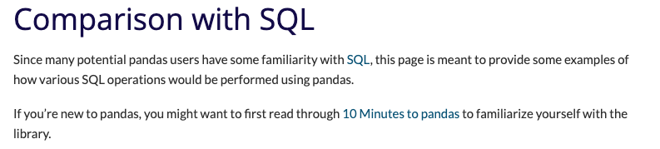
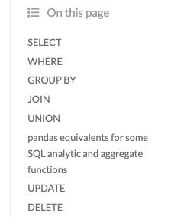
Pandas and SQL
There are a lot of common functions/capabilities.
There are also a lot of advanced numeric functions in Pandas, e.g.
Windowing
3D Panels
Advanced math operations.
SQL has much more powerful WHERE capabilities, indexing, constraints, ... ...

Slide 19
Let’s Look at the Data
Another example ... ...

Slide 20
Wide Flat Tables are Cool
But, ... What if the Underlying Data Changes?
In many cases, it is not a critical issue.
Millions of transactions in Europe
Over dozens of months.
My annual report’s errors will not be huge if I miss that last few transactions.
But, if it does matter:
Use an event-based mechanism to propagate changes in the underlying data
Into the processed, wide-flat table
There are several approaches
The most “database centric” are triggers.
Suppose an orderDetails gets added to an order. The INSERT trigger can get all the information necessary to add a new row to the wide-flat-table.
I love asking questions like this on finals.

Slide 21
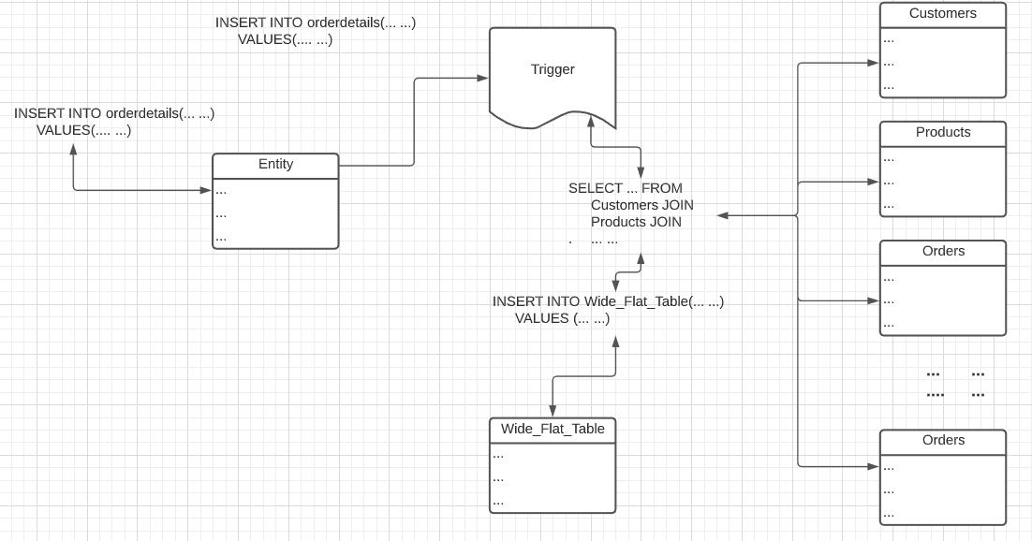
Update Wide Flat Tables
Triggers can synchronously update the wide flat table or
Write to a change table, and then process all in overnight job.

Slide 22
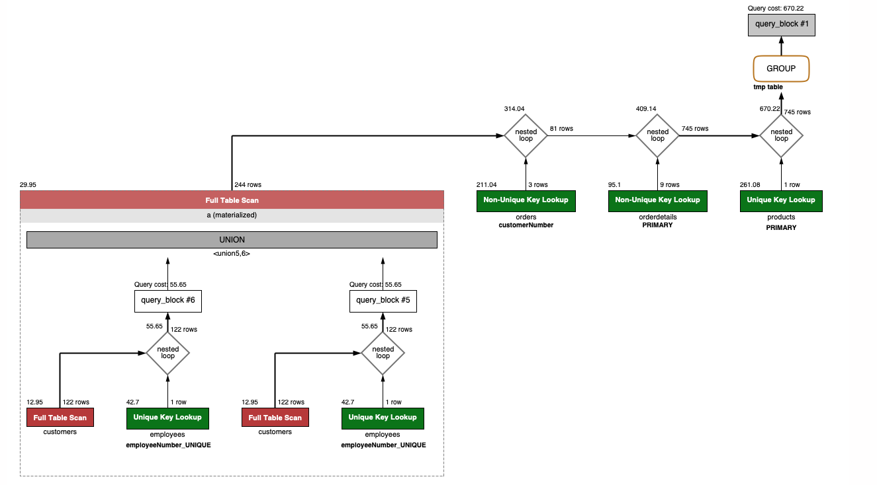
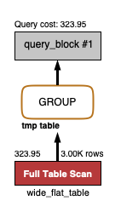
Performance
For the small datasets, wide flat view is 2X wide flat table.
But, these are small tables. JOIN cost is O(#(L)*#(R)) and there are several joins. The wide flat table scan is O(#S)
Wide Flat Table
Wide Flat View

Slide 23
Object Relational Mapping
Lecture 13: We’re Done(Almost), Yeah! © Donald F. Ferguson, 2020

Slide 24
Object Relational Mapping
Most modern programming language are “object oriented.”
The application has a set of classes.
Programs/functions manipulate the object instances of the class.
OO is also “Entity Relationship”
Entity type == Class
Entity collection == Collection (Extent)
Properties == Object fields/properties
But, most databases are no OO. I have to convert between the DB model and the OO language model.
This is tedious, repetitive and boring.

Slide 25
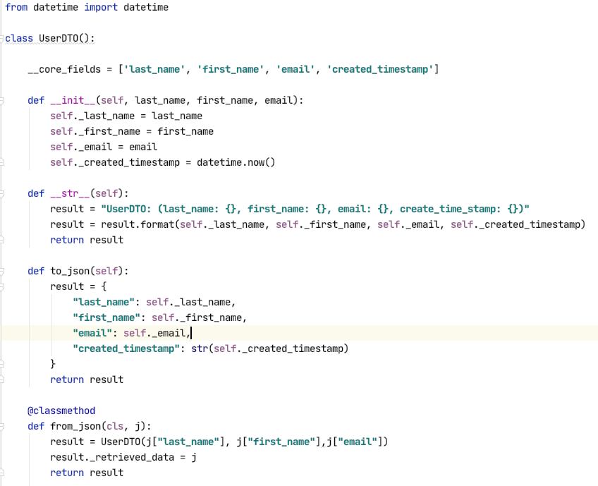
Object Relational Mapping
Azure Cosmos DB:
NoSQL
JSON is basic type
PaaS
What if:
I want to use Cosmos DB
But have objects?
I have to map back/forth
Python objects
JSON documents
That harshes my mellow. There should be tools.

Slide 26
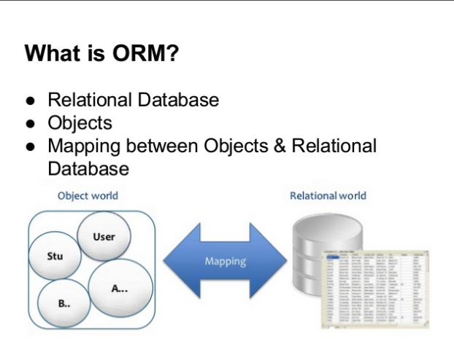
Object Relational Mapping
From Wikipedia: “Object-relational mapping (ORM, O/RM, and O/R mapping tool) in computer science is a programming technique for converting data between incompatible type systems using object-oriented programming languages. This creates, in effect, a "virtual object database" that can be used from within the programming language. There are both free and commercial packages available that perform object-relational mapping, although some programmers opt to construct their own ORM tools.”
I cannot be the only person who wants to do this!
There should be some tools for this.
“Dear Google,
I hope this questions finds you in good health.
I have ... ...”
Seriously dude, there a lot of them.

Slide 27
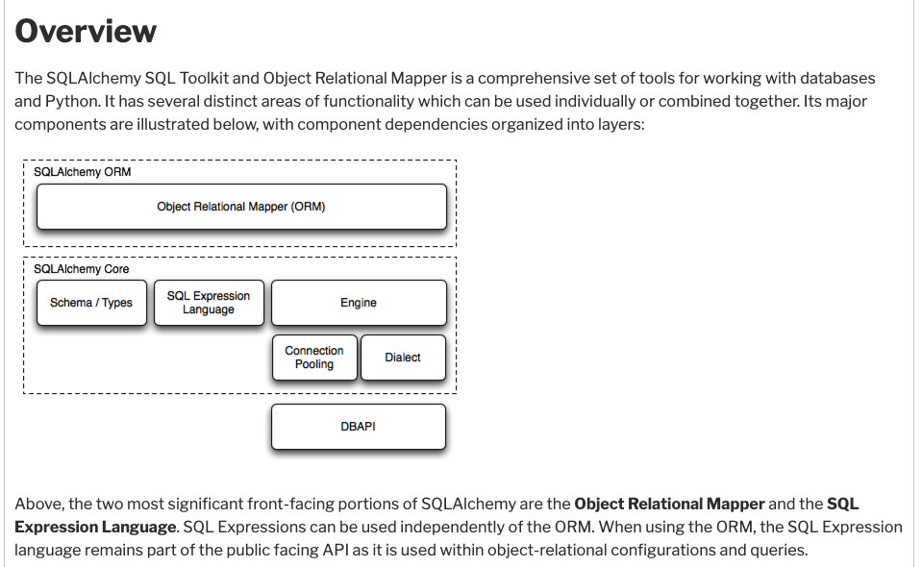
SQL Alchemy is a Common Tool in Python
You have seen me use SQLAlchemy in notebooks.
The %SQL extension uses it.

Slide 28
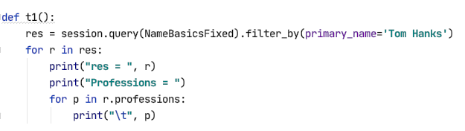
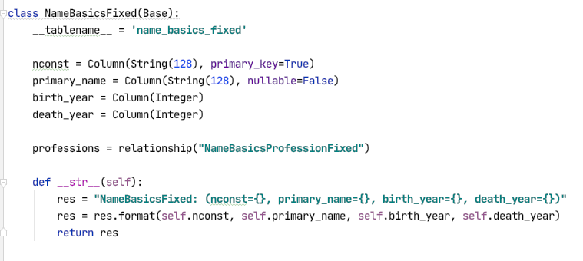
SQL Alchemy is a Common Tool in Python
You declare the mapping of class ←→ table, property ←→ column, ... ...
The SQLAlchemy engine and library automates mapping and implement and more “object method like approach to query.

Slide 29
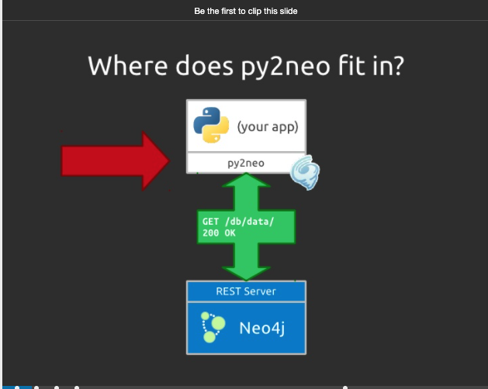
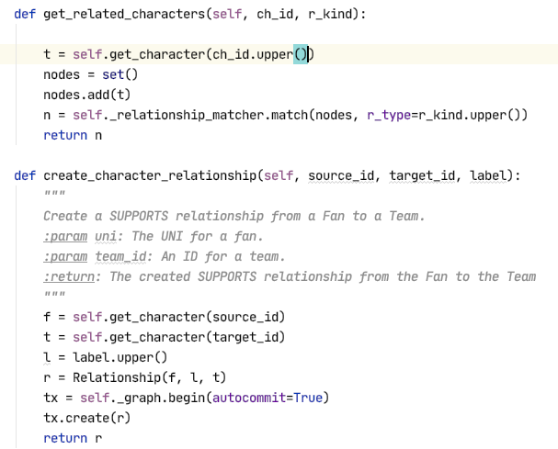
There is also Py2neo
There are some examples in the project repo you cloned.
https://www2.slideshare.net/nigelsmall/introduction-to-py2neo

Slide 30
Web Application Walkthrough
Lecture 13: We’re Done(Almost), Yeah! © Donald F. Ferguson, 2020

Slide 31
Web Applications
https://reinvently.com/blog/fundamentals-web-application-architecture/

Slide 32
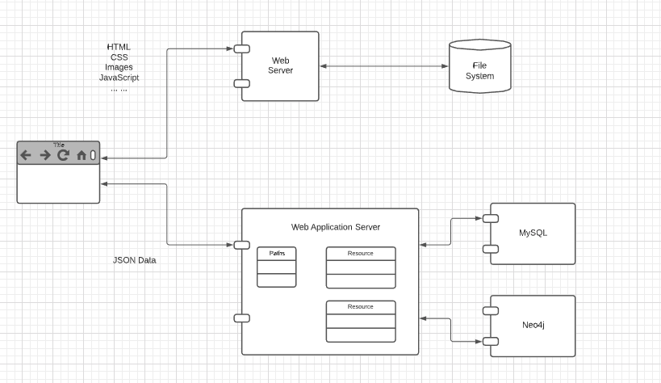
Web Applications

Slide 33
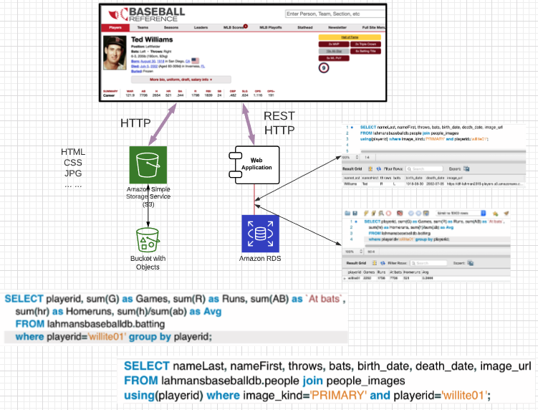
How Do You Make a Page Like This?
We talked about how the web is like a database of resources.
GET /players?nameLast=
GET /players/willite01
GET /career_batting/willite01
... ...
Web application:
Converts REST calls into
SQL statements
Returns data to browser.
Browser uses HTTP to get hyperlinked documents.

Slide 34
REST Makes the Web Like a Database
Entity Set == Resource Collection, Entity == Resource, Attribute == Property
CRUD operations == {POST, GET, PUT/PATCH, DELETE}
Relationships == Hyper Links/URLs

Slide 35
Switch to HW4 Notebook
Switch to notebook.
Walk through some web apps, including Baseball.

